Slide 1




Data Analysis
Project for
Social Buzz
Presented By: Swayam
Last Updated: November 23th, 2022

Slide 2


Today's agenda
Project Recap
Problem
The Analytics Team
Process
Insights
Summary
Notes:
Today's agenda will be as follows:
1. We will recap the overall project to give a high level understanding of the business problem we're tackling and the specific requirements.
2. We will dive into the specific problem that we, the Data Analytics team, have been focusing on and will give some background as to why this is such a big problem.
3. After introducing the problem, I will go over the team responsible from our side in tackling this task.
4. I will then go over the high-level process that we followed to complete this task, so that you have complete clarity in how we tackle these kinds of tasks.
5. Finally, I will go over the all important results and I will present them as a series of insights and visualizations from our analysis.
To wrap up, I will summarize and open for any questions.

Slide 3

Social Buzz is fast growing technology unicorn that need to adapt quickly to its global scale. Accenture has begun a 3-month Project in order, avidly focusing on these tasks:
An audit of their big data practice
Recommendations for a successful IPO
An analysis of their content categories that highlights the top 5 categories with the largest aggregate popularity
Project Recap
Notes:
To kick things off let me recap this engagement.
We, Accenture have embarked on a 3 month pilot with Social Buzz to focus on 3 main tasks, aligned with some of the biggest challenges that you're currently facing.
Social Buzz has reached huge scale in recent years to become recognized as a global unicorn company. We are here to help you manage this scale and to guide you in the right direction.
Firstly, we will be doing an audit of your big data practice and sharing best practices and industry expertise. Secondly we will be guiding you through a successful IPO, of which we have deep expertise and knowledge of within our team. And finally, we have conducted an analysis of your data to find insights regarding your top 5 most popular categories of content

Slide 4


Problem
Every day over 100,000 pieces of content, ranging from text, images, videos and GIFs are posted
Data is highly unstructured.
As to how the company can capitalize and increase profits from this data.
Analysis to find Social Buzz’s Top 5 Popular categories of content.
Notes:
Focusing on the last point that I mentioned there, this is what the Data Analytics team has been specifically focused on.
Clearly with such grand scale, this comes with a lot of data and with such vast amounts of data comes challenges.
To give a background on how much data you've been creating:
- You told us that your platform receives over 100000 posts per day which amounts to 36 500 000 posts every year, of which, this is all unstructured data making it very hard to make sense of.
In this day and age, content is king. Just look at some of the biggest platforms in the world, for example YouTube, Facebook and Netflix... they are all content businesses...
But how to capitalize on it when there is so much?
It's not just all about harvesting as much content as possible... The real value is in understanding and crunching this content to gain a deeper understanding of your audience and to therefore provide a more personalized and enjoyable experience.
And this is where out data analytics expertise comes in, with the insights that we've uncovered from this task, we can show you exactly how to take analytics to production at scale.

Slide 5



The Analytics team
Notes:
Talking about experience, we have a large data analytics practice at Accenture but we had a team of 3 people primarily focusing on this task. Andrew Fleming is our Chief Technical Architect and his expertise really helped to guide the team to produce high quality analysis.
Marcus Rompton, a senior data expert has worked with the worlds biggest clients on solving their data problems and was heavily involved in the data engineering side of this project.
And finally myself, [NAME], who was solely responsible for taking leadership guidance and delivering high quality insights from the raw datasets and turning these into business decisions.

Slide 6

Process
1
Data Understanding
2
Data Extraction
3
Data Cleaning & Modelling
4
Data Analysis
5
Data Insights
Notes:
So, how did we tackle this problem?
Well, we approached it in 5 steps:
1. Data understanding - the key to success on any data project is to understand the data in detail. So we took the time to understand the data model and domain of your business.
2. Data extraction - after understanding your business, we then architected what an ideal dataset should look like for this problem and extracted it from the relevant data sources.
3. After extracting the raw data, we needed to process and model this data into a dataset that can precisely answer the business questions and produce analytics.
4. With our new dataset, we used our analytical expertise to uncover insights from this dataset and to produce visualizations to describe the insights.
5. And finally we used these insights to unlock business decisions and to make recommendations on next steps.

Slide 7




Insights
16
Unique Categories
1897
Reactions to ‘Animals’ post
May
Month with most Posts
Notes:
From your data we found that you had a total of 16 unique categories of posts across your sample dataset. This includes things such as Animals, Science AND Healthy eating.
As well as this, there was 1897 posts from just the animals category alone! People obviously really like watching animals !
And also the most common month for users to post within was May, since this is such a seasonal month with so many holidays and events, this is interesting to know that people are most active during this month!
But now, onto the main question... which is... what were the top 5 most popular categories of posts?

Slide 8
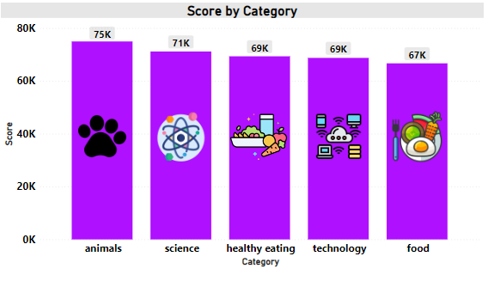
Category wise ‘Popularity’ Score
Animals and Science are the two most popular categories of content showing that people really prefer a natural, realistic and actual fact based content the most.
Notes:
From our analysis you can see that the top 5 most popular categories of posts were animals, science, healthy eating, technology and food in descending order.
Animals had an aggregate popularity score of almost 75000. It is very interesting to see both Healthy eating and food within the top 5, it really shows that people are Trying to become more heath conscious and are trying to consume content regarding heathy eating and foods. But also interesting to see science too. Clearly users favor updating themselves with the current technology and development in science. As well they are trying to give more attention towards their health, as during todays times many people are working from home and working remotely. So they are trying to be fit by consuming content regarding healthy eating.
Furthermore technology is an interesting category because due to emergence of modern day techs such as big data, cybersecurity, cloud computing, etc. This presents a huge opportunity for you to differentiate your platform and to run specific content or events linked to this global spectacle.

Slide 9
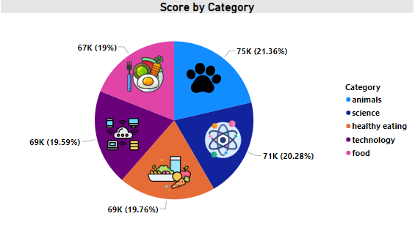
Category wise ‘Popularity’ Score by %
Animals and Science are the two most popular categories which represent almost 21% and 20% by overall total %.
This shows major chunk of revenue comes from this two categories.
Notes:
Additionally, you can see from this chart the % split of popularity between the top 5 categories. There is much difference between each of them, animals only outperforms science by 1.08% within the top 5.
However the difference between the 4th most popular, technology, and the 5th most popular, food, is at 0.56%
This tells me that the categories sorted by popularity is weighted towards categories at the top. This means that it exhibits a "greedy" effect, the most popular categories get more popular whilst as you drop down the popularity rankings, you may see that they fall away drastically.

Slide 10
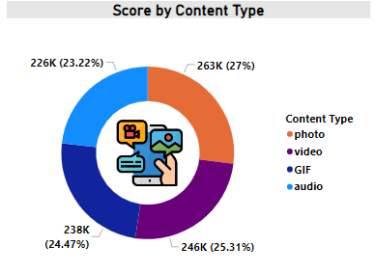
Content wise ‘Popularity’ Score by %
Our data shows most popular
content type.
Photo and Video represent the most viewed type of content over others.
This shows people are realistic and love to experience the reality.
Notes:
Also, you can see from this chart the % split of type of content categories.
However the difference between the 1st content type, photo, and the 2nd content type, video, is much larger at 1%
This tells us that the user love more to consume content which is pictures rather than video. In fact, this shows people love to watch photos than watching videos, which saves time to absorb the content.

Slide 11
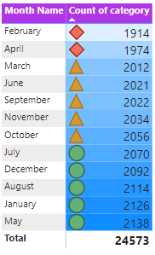
Monthly Content Post
Our data shows the categories of content posted by month.
May and January are the month wherein people posted the most.
Especially, in month of May there were 2138 posts posted on Social Buzz.
This shows as summers are free time, people engage oftenly.
As we can generate more marketing campaigns in this period to increase our revenue and profit.
Notes:
This shows that the category posts were maximum in month of may. This shows that people prefer to consume more content during summer vacations or during summers. As people tend to travel to many places more, rather during other months.
As we can work more on providing more content during summer or in month of may as people enjoy outing with their families. As this can generate more revenue and also profit during month of may.

Slide 12
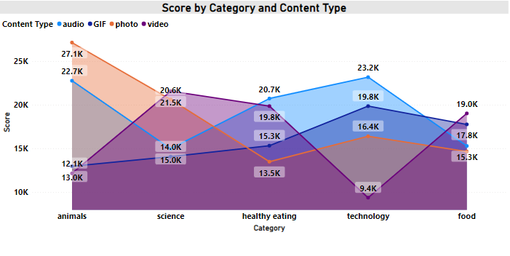
Category by ‘Popularity’ score & by Content type
Notes:
This shows the category popularity score with respect to the content type. By this, we can infer that people prefer to see pictures of our top category i.e. animals , then in science, people prefer to watch video to understand the content, while people prefer audio content in categories related to healthy eating eating and technology, and in food category they prefer video content.
As we can work more on providing more specific type of content specific to specific category, which in turn will increase our profits and revenue.

Slide 13
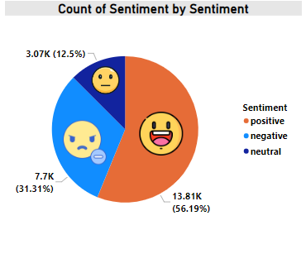
Sentiment distribution
This shows that
Around 60% of customers loved the content .
Around 31% were not satisfied about the overall content provide.
Around 13% remain neutral

Slide 14


ANALYSIS
Animals and Science are the two most popular categories of content showing that people really prefer a natural, realistic and actual fact based content the most.
INSIGHTS
The most common themes of this analysis are ‘FOOD’ AND ‘SCIENCE & TECHNOLOGY’. Using this, better and targeted campaigns can be generated focusing on healthy eating and science and advanced technologies which people love to prefer . As people are becoming more advanced with smart techs, also people are turning more health conscious.
This can help generate more profit and revenue thereby focusing on crisp themes which people really love .
Summary
Notes:
So to summarize:
We tackled this task and found the top 5 most popular categories as asked, but we also went one step further.
- We found that food, science and technology are the two most popular categories, suggesting that users like "real-life" content
- We also found that healthy eating was the third most popular, perhaps due to the people turning health conscious. This presents a massive opportunity for Social Buzz to ride on this content category, as people will spend more on consuming healthy foods- As much as this analysis was insightful, we are ready to take it to the next stage and we have the expertise within Accenture to help you realize these kinds of insights in production across your organization and in real time. We would love to help you with this.

Slide 15

Thank you!
ANY QUESTIONS?
Notes:
Thank you very much for listening, please feel free to ask any questions that you may have!

